Slide 1





28 Febrero 2026
09:00 AM – 18:00 PM CST
CEU San Pablo
Madrid, Spain
https://globalai.es/
#AgentCamp #GlobalAICommunity

Slide 2



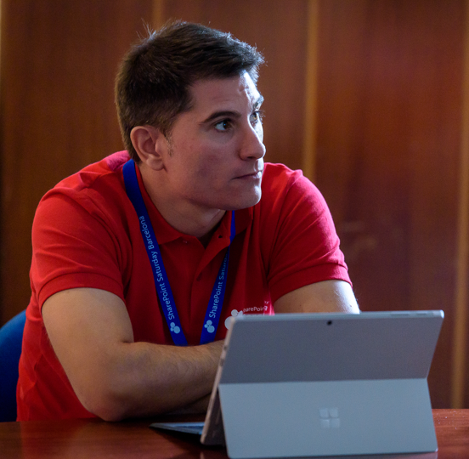
Model Context Protocol
Authorization Unleashed
Luis Mañez
Sr. Software Engineer
ClearPeople LTD
@luismanez
#AgentCamp #GlobalAICommunity

Slide 3












¡Gracias a nuestros Patrocinadores!
PREMIUM
GOLD
Colaboradores:

Slide 4

Join the AI Conversation on Discord
gaic.io/discord

Slide 5
Model Context Protocol
Introduction

Slide 6
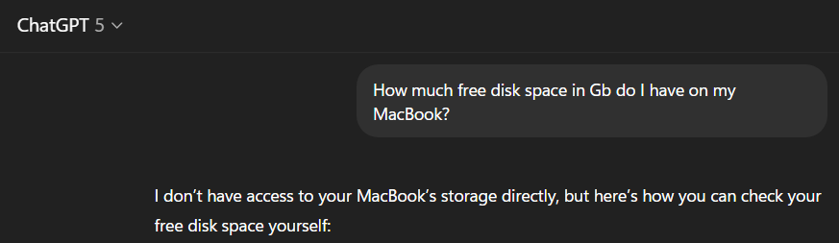
Why do we need this (sh1t)!

Slide 7
What is MCP (yet another protocol)
Model
Context
Protocol

Slide 8
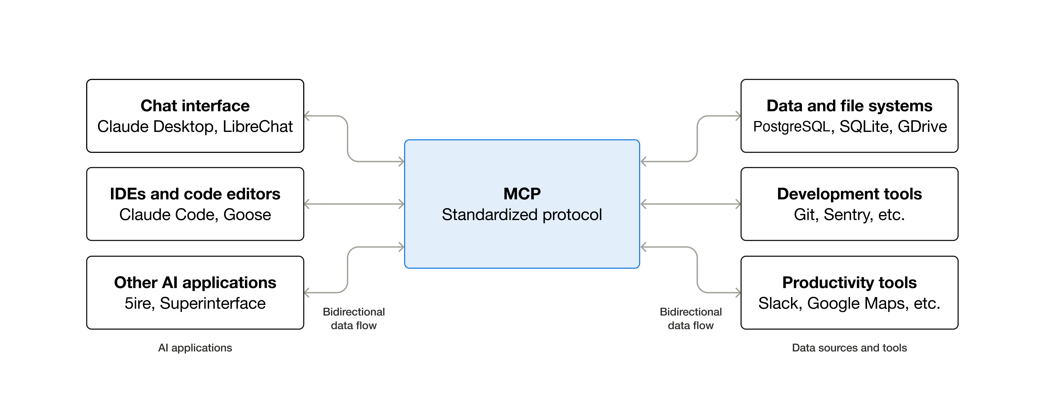

Slide 9
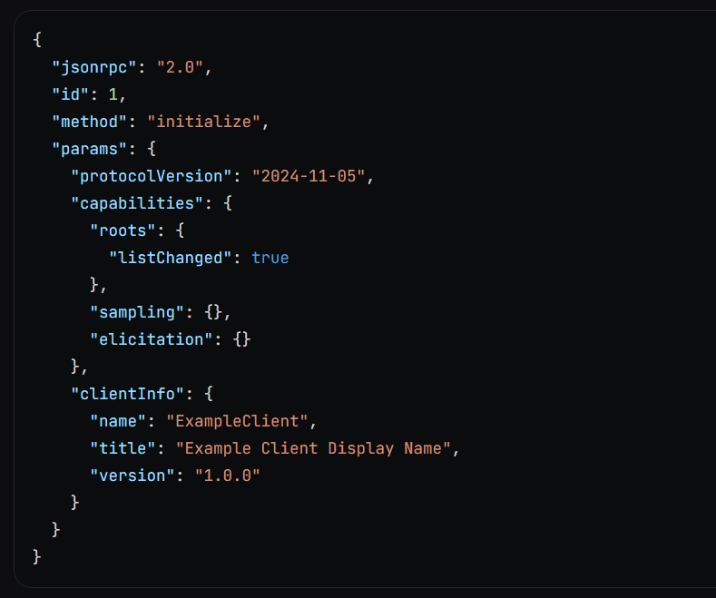
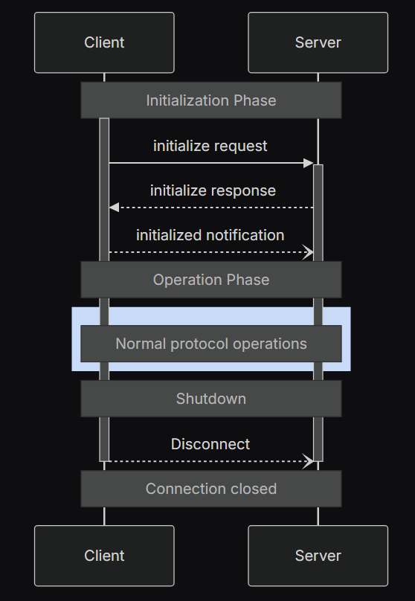

MCP Protocol
JSON-RPC
Lifecycle
Transport
stdio
Streamable HTTP
SSE
(deprecated)

Slide 10
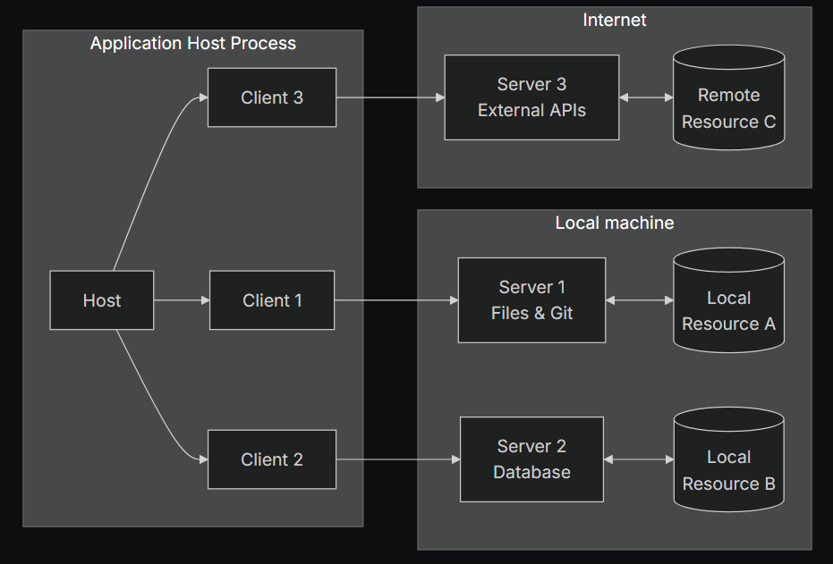

Slide 11
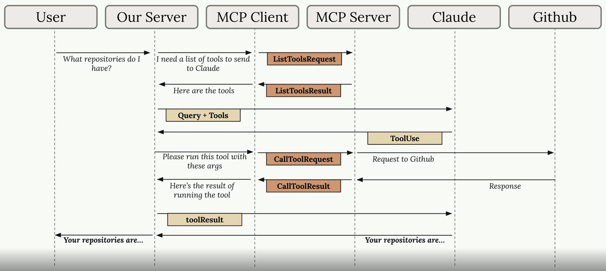
Anthropic “Introduction to MCP” Couse
https://anthropic.skilljar.com/introduction-to-model-context-protocol/

Slide 12




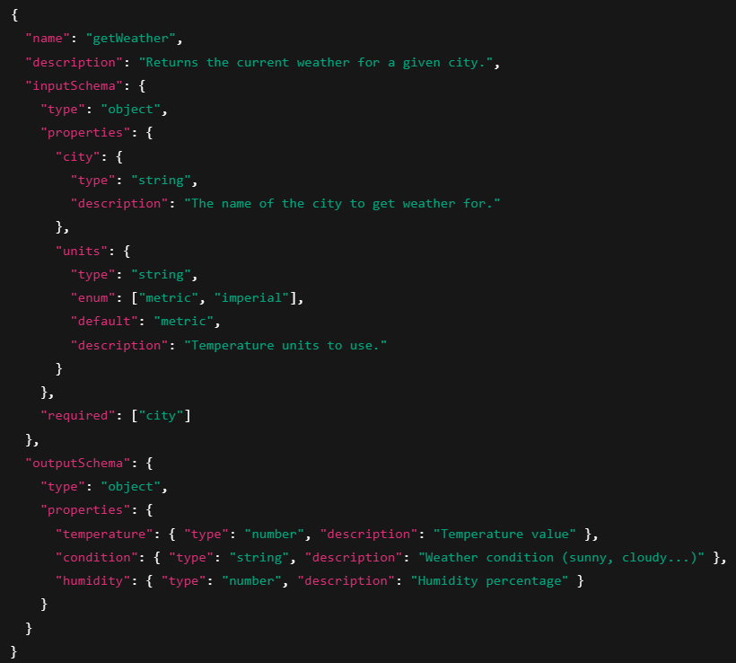
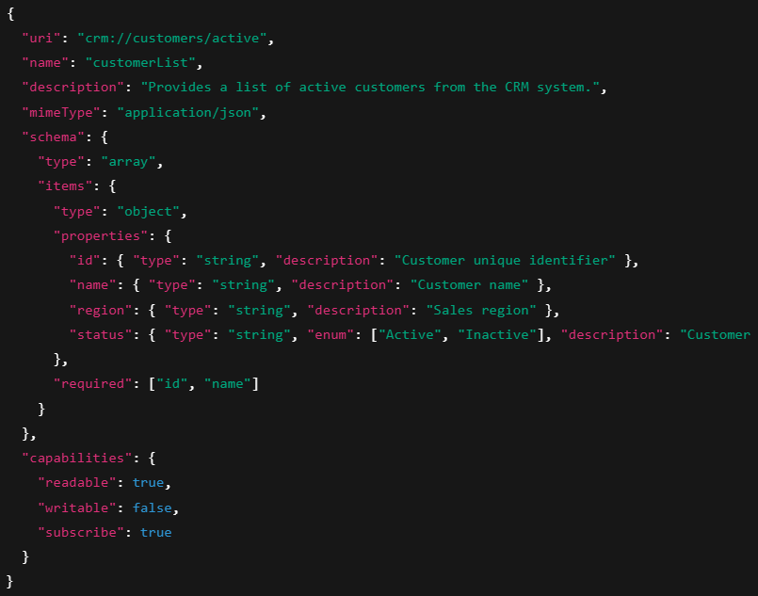
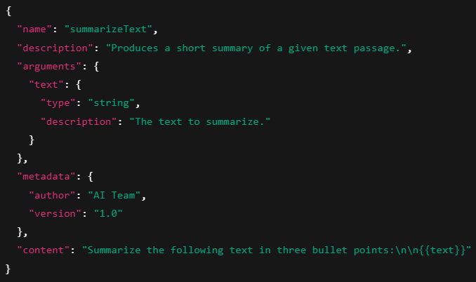
MCP Server Features
Tools
Resources
Prompts
Functions exposed to the LLM to take actions
Contextual data attached and managed by the client
Interactive templates invoked by user choice
API POST requests, file writing
Slash commands, menu options
File contents, git history

Slide 13



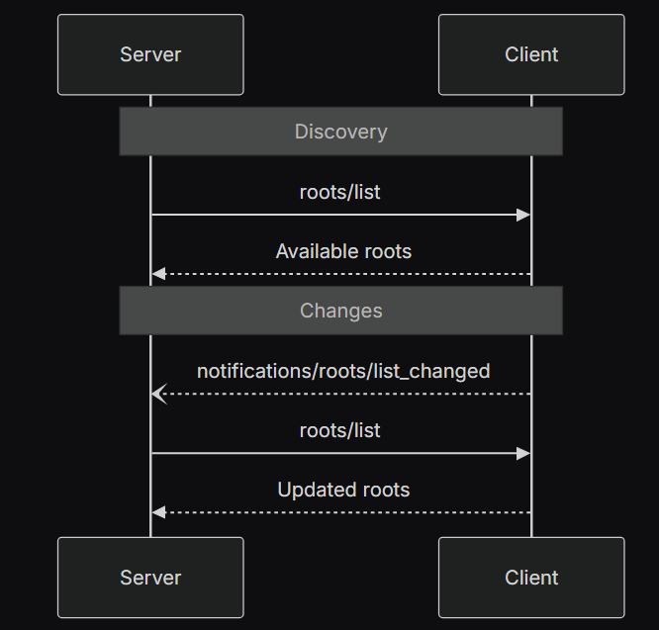
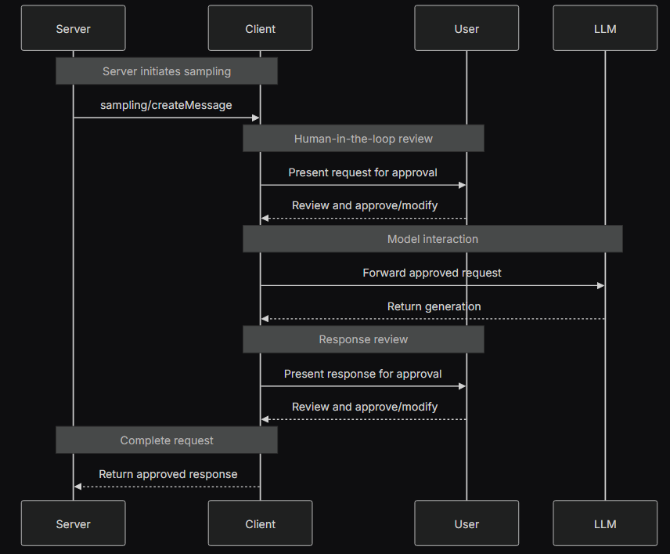
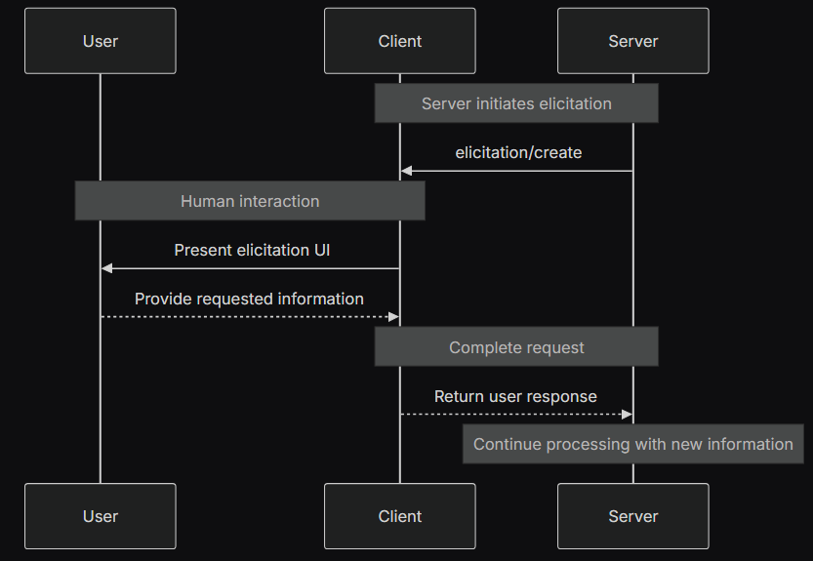
MCP Client Features
Roots
Sampling
Elicitation
Clients can expose filesystem “roots” to servers.
Servers can request LLM sampling (“completions” or “generations”) from language models via clients.
Servers can request additional information from users through the client
/your-project
/temp
How old are you?
Hey LLM, please summarise this user query in a Keyword Query Language format.

Slide 14

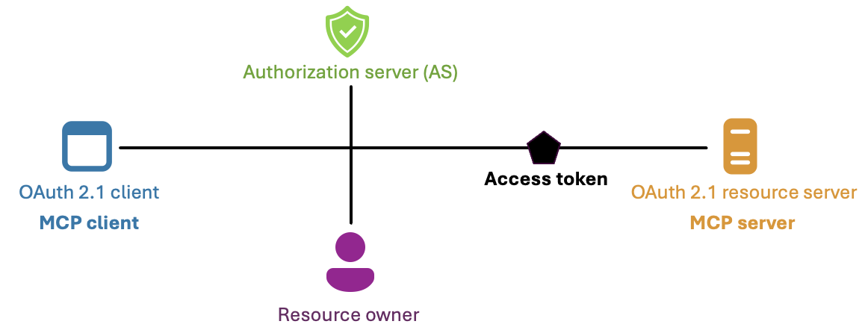
MCP Authorization
Based on oAuth 2.1 standard

Slide 15
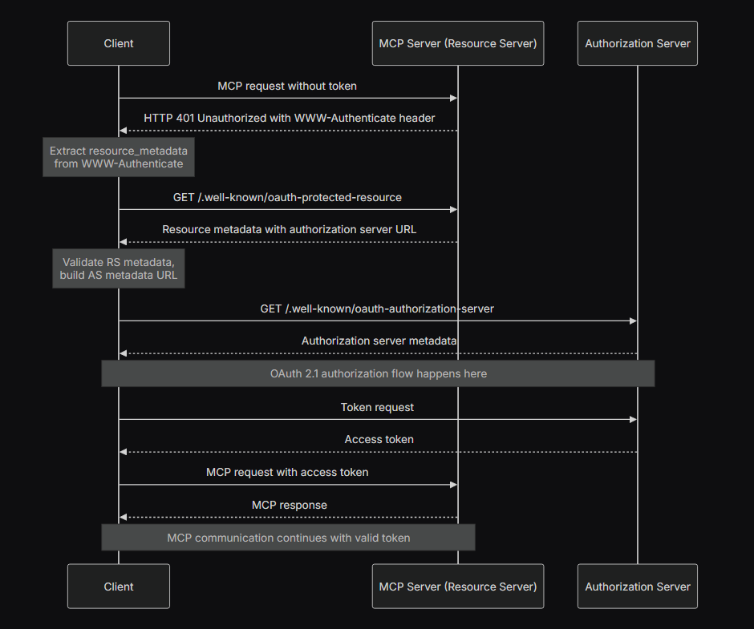
MCP Authorization

Slide 16
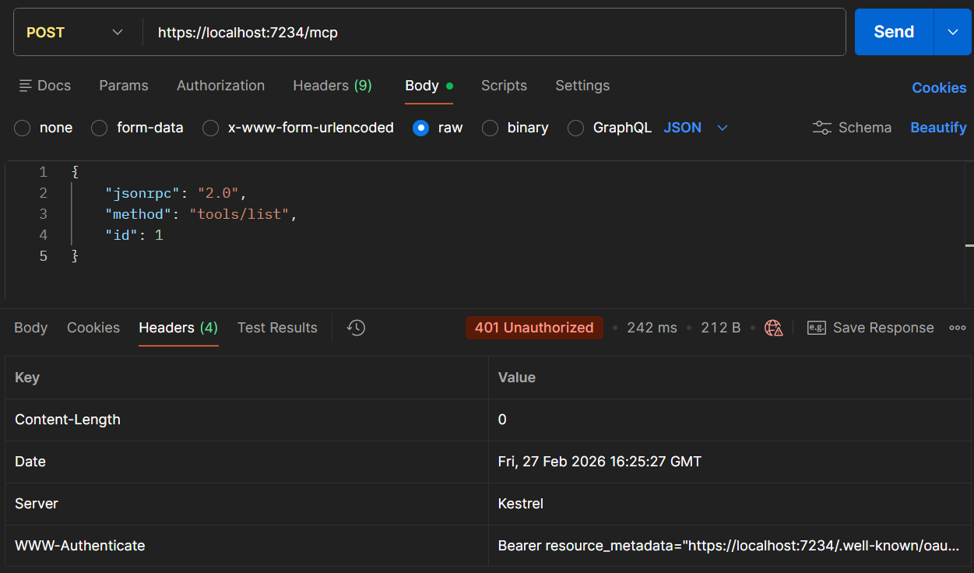
Bearer resource_metadata="https://localhost:7234/.well-known/oauth-protected-resource/mcp"

Slide 17
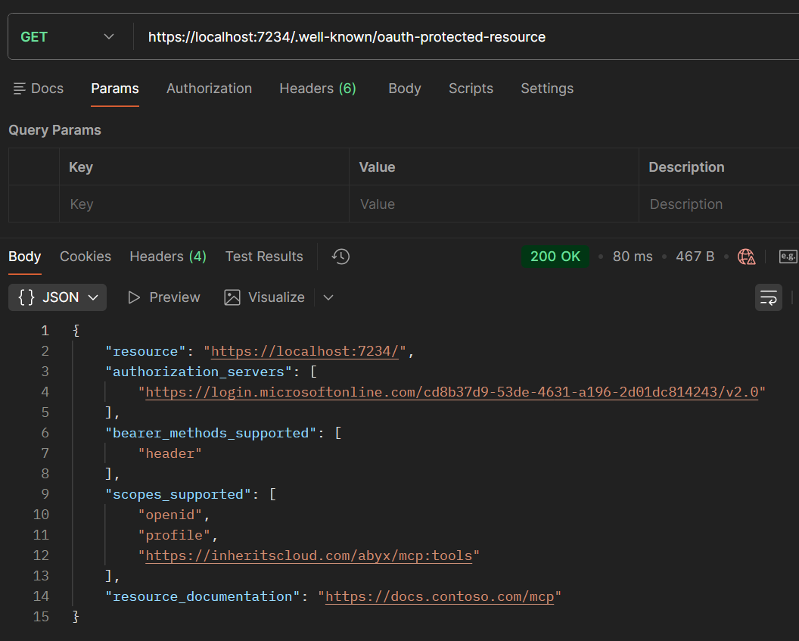

Slide 18
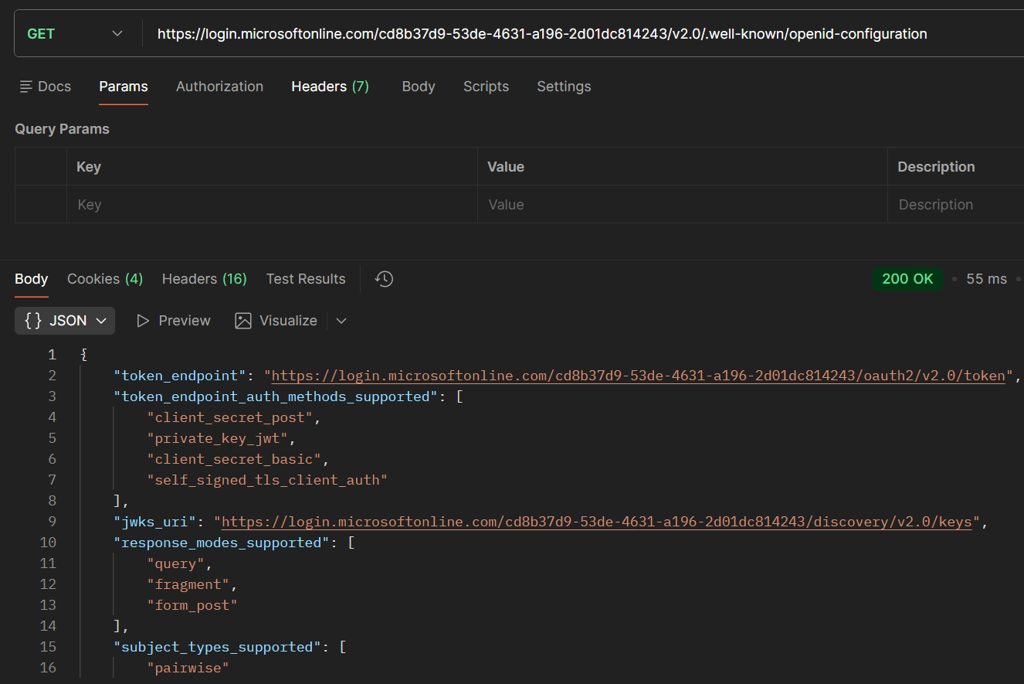

Slide 19

Client Registration
Dynamic Client Registration
Client ID Metadata
Manual Registration
MS Entra ID

Slide 20
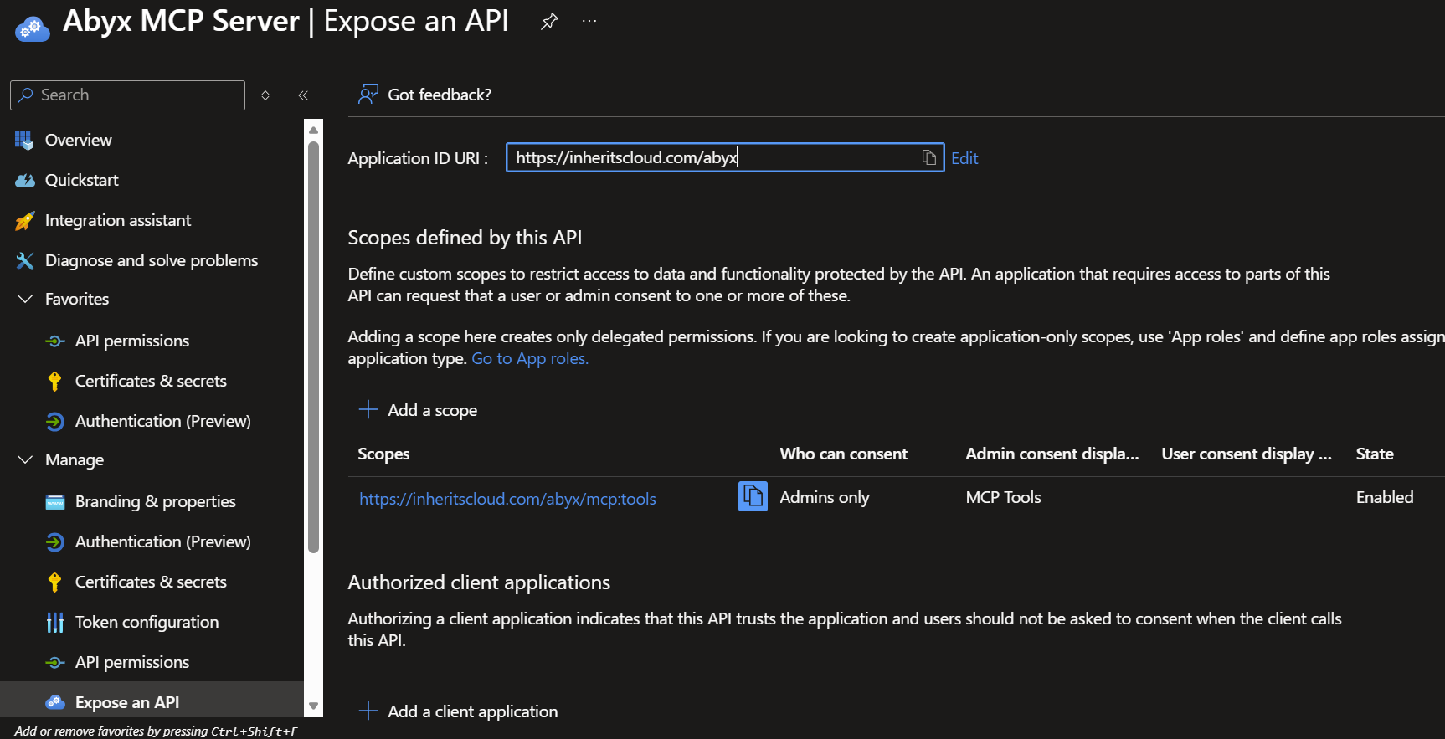
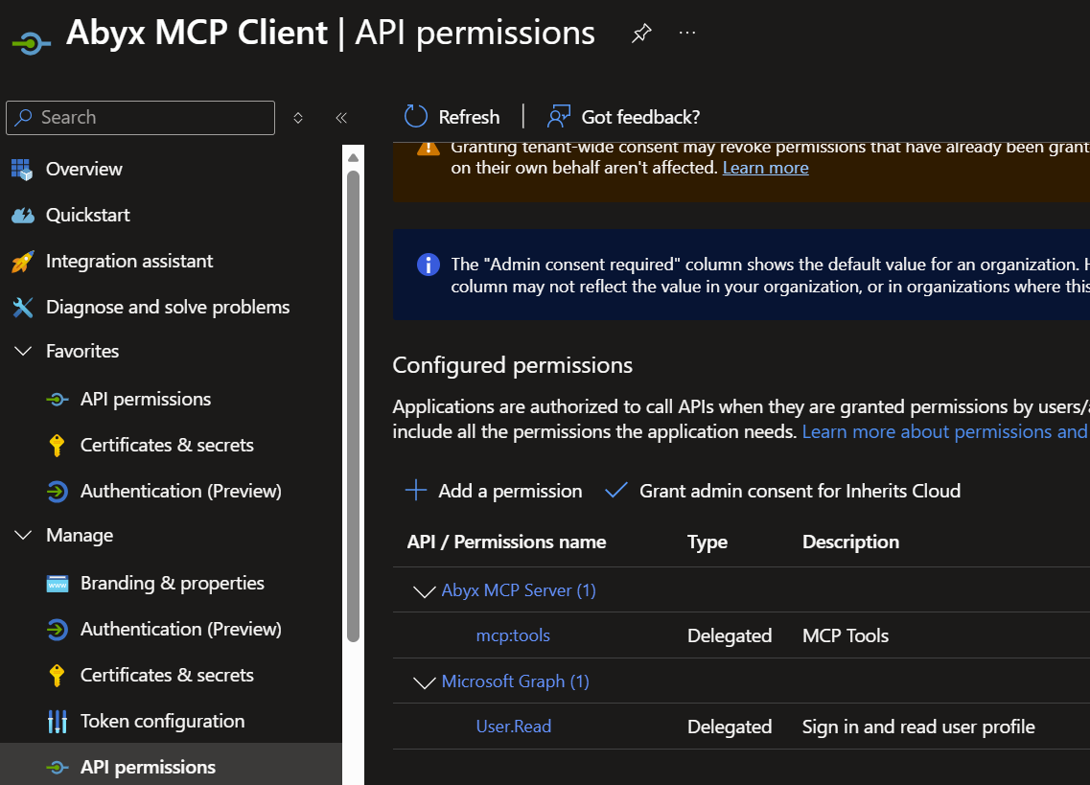
Entra ID Registration
MCP Server App
MCP Client App

Slide 21
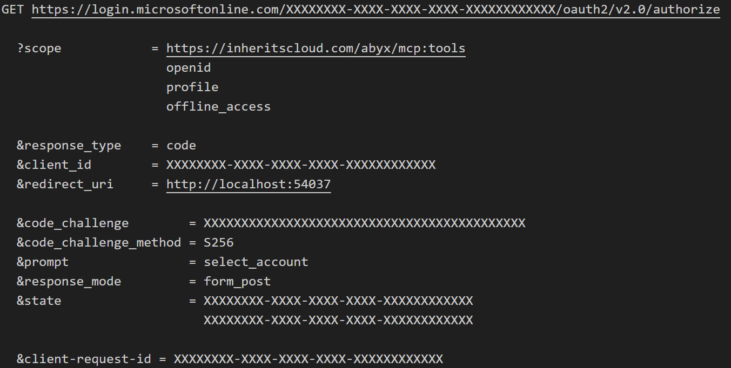
oAuth 2.1 Flow

Slide 22
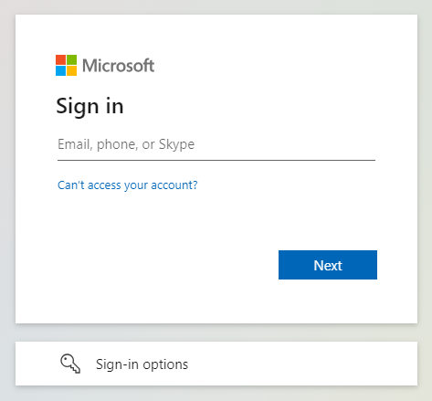
Entra ID Sign In

Slide 23
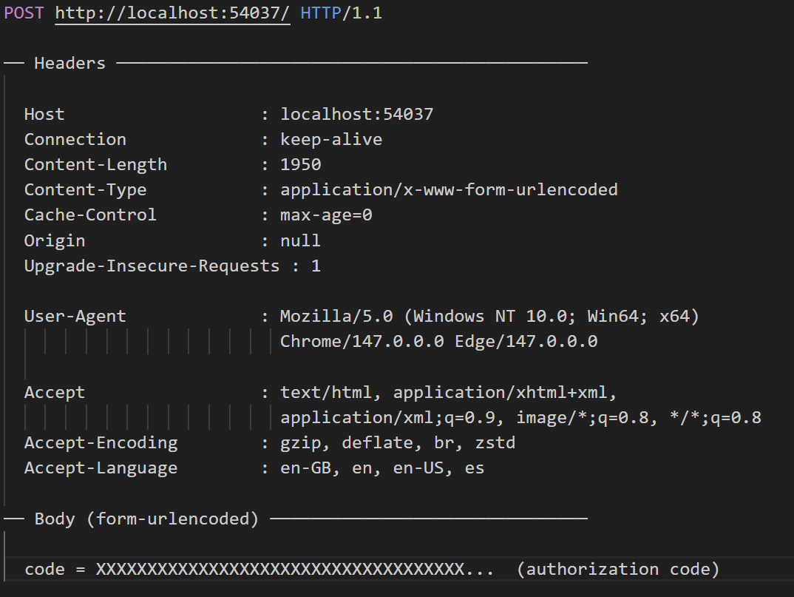
Redirect with Code

Slide 24
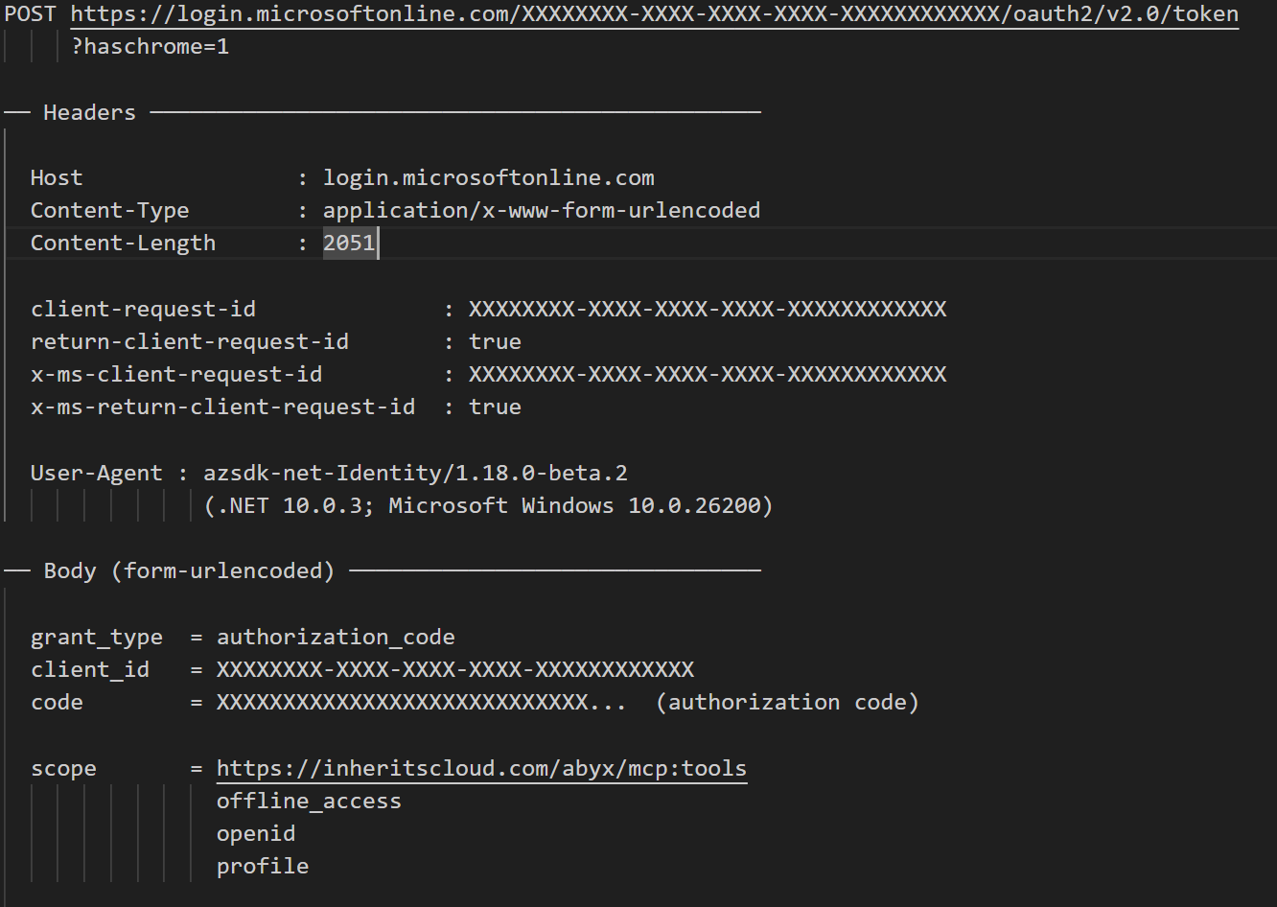
Get Token

Slide 25
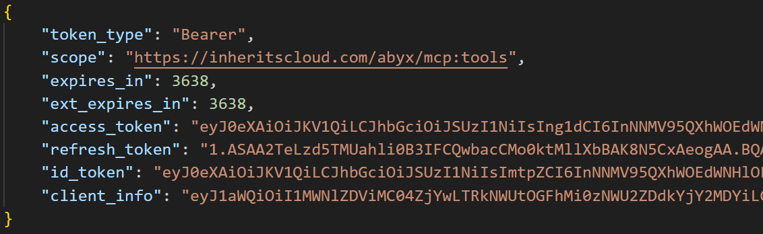

Slide 26
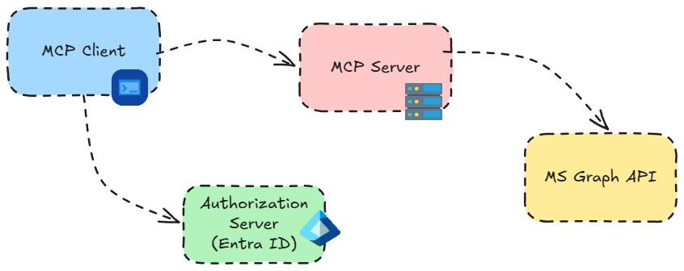
Demo Architecture

Slide 27
https://github.com/luismanez/agentcamp-madrid-2026

Slide 28
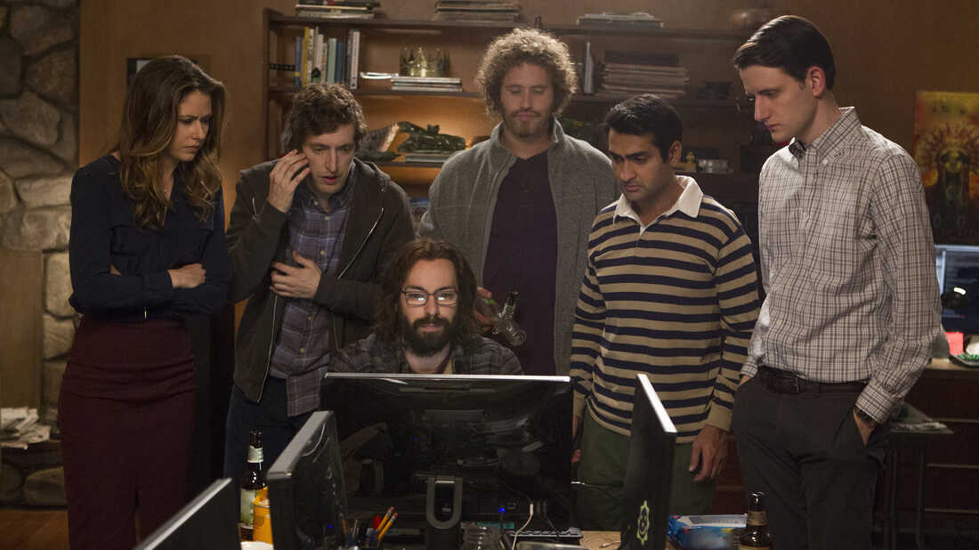

Show me the code !!

Slide 29
¡Gracias a nuestros Patrocinadores!
PREMIUM
GOLD
Colaboradores:

Slide 30
¡Gracias!
https://globalai.es/
#AgentCamp #GlobalAICommunity

